Slide 1
Group 27
Group member:
311551126 巫建泓
311551137 陳麒鈞
311551161 顏琳恩
311551165 江佳穎
311554060 張偉誠
0886004 周芝妤

Slide 2
Outline
User story
UI/UX design
Architecture
User requirements & unit test
Earthquake
Electricity
Reservoir

Slide 3
User story
Homepage
Earthquake
Electricity
Reservoir

Slide 4
User story
Webpages | Homepage |  | Earthquake / Electricity / Reservoir
Feature | 網站導覽 Navigation |  | 回到首頁
Descriptions | AS A I WANT SO THAT GIVEN WHEN THEN GIVEN WHEN THEN | 使用者 快速瞭解網站有哪些頁面 我可以找到自己要的資訊 開啟網頁 進入首頁 應該要看到首頁有標示電力資訊 (Electricity)、水情狀況 (Reservoir) 跟地震資訊 (Earthquake) 的按鍵 我正在網站首頁 點擊進入某個頁面的按鍵 應該要進入相對應的子頁面 | AS A I WANT SO THAT GIVEN WHEN THEN GIVEN WHEN THEN | 使用者 回到網站首頁 我可以進到其他子頁面 我在任意子頁面 滑到頁面左方導覽 應該要看到「首頁」按鍵 (Homepage) 我在任意子頁面 點擊「首頁」 (Homepage) 我應該能回到網站首頁

Slide 5
User story
Webpages | Electricity |  | Reservoir |  | Earthquake
Feature | 電力負載狀況監控 |  | 水庫剩餘量監控 |  | 地震震度監控
Descriptions | AS A I WANT SO THAT GIVEN WHEN THEN | 廠務工程師 即時查看電力負載狀況 我可以評估可能的供電危機 我正在網站首頁 我進入電力頁面 應該要看到各地的即時供電量、用電量、供應人數以及人均用電量 | AS A I WANT SO THAT GIVEN WHEN THEN | 廠務工程師 即時查看水庫剩餘水量 我可以評估可能的供水危機 我正在網站首頁 我進入水庫資訊頁面 應該要看到各水庫的剩餘水量及百分比 | AS A I WANT SO THAT GIVEN WHEN THEN | 廠務工程師 查看最近的地震紀錄 我可以評估目前各地災情 我正在網站裡 我進入地震頁面 應該要看到近期地震之位置、深度、規模、強度

Slide 6
User story
Webpages | Homepage |  | Homepage |  | Homepage
Feature | 警示地震 |  | 警示電力不足 |  | 警示水量異常
Descriptions | AS A I WANT SO THAT GIVEN WHEN THEN GIVEN WHEN THEN | 廠務工程師 即時收到地震警示 我可以根據警示制定緊急應對計劃 我正在網站裡 地震發生 網站應該跳出地震警示 我正在網站裡 地震發生且震度大於 3級、4級、5級 網站分別會顯示輕微、中等、嚴重的地震警示 | AS A I WANT SO THAT GIVEN WHEN THEN | 廠務工程師 即時收到缺電警示 我可以根據警示調整工廠的用電策略 我正在網站裡 剩餘電量少於 10%、6%、 3% 網站分別會顯示輕微、中等、嚴重的缺電警示 | AS A I WANT SO THAT GIVEN WHEN THEN | 廠務工程師 即時收到水量警示 我可以根據警示調整工廠的用水計畫 我正在網站裡 某水庫剩餘水量低於 30%或高於 90%、低於 20%、低於 10% 網站分別會顯示輕微、中等、嚴重的水情警示

Slide 7
UI / UX design
Homepage
Earthquake
Electricity
Reservoir

Slide 8
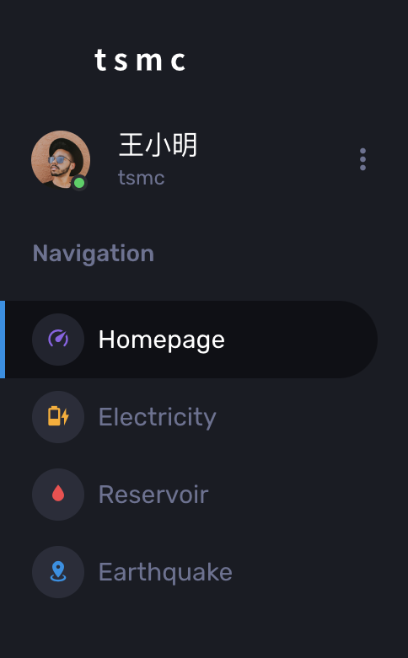
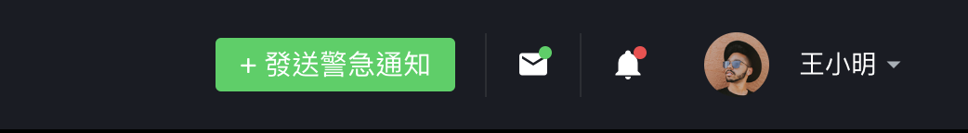
UI/UX design
Seamless navigation: Users can easily switch between pages without any delays or complications.
Improved user experience: The intuitive placement of page links enhances user satisfaction and efficiency.
Quick access to personal information: Users can conveniently view their personal details in the navigation area.
Notes:
Overall design-wise, we aim to provide users with the ability to quickly navigate between pages regardless of their location within the system.
To achieve this, we have placed links to various pages in the sidebar. Additionally, user-specific information and other relevant details are displayed in the navigation section.

Slide 9
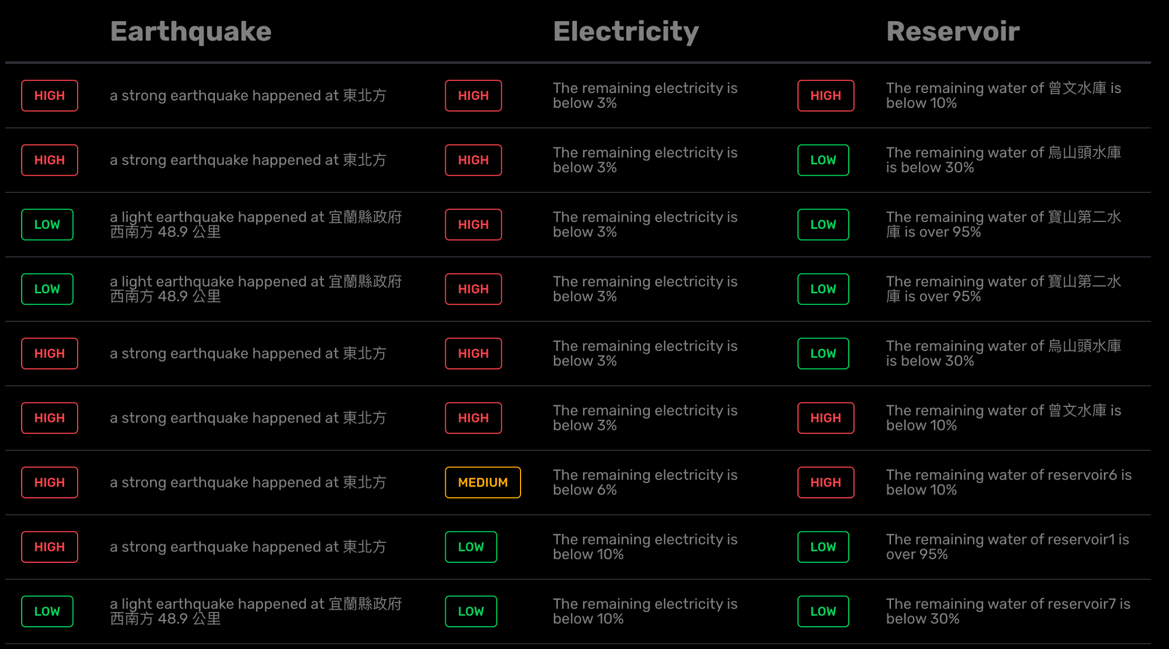
UI/UX design - Homepage
Consolidate information on earthquakes, reservoirs, and electricity.
Provide users with a clear overview of the system's overall status.
Enable users to gain comprehensive insights upon entering the system.

Slide 10
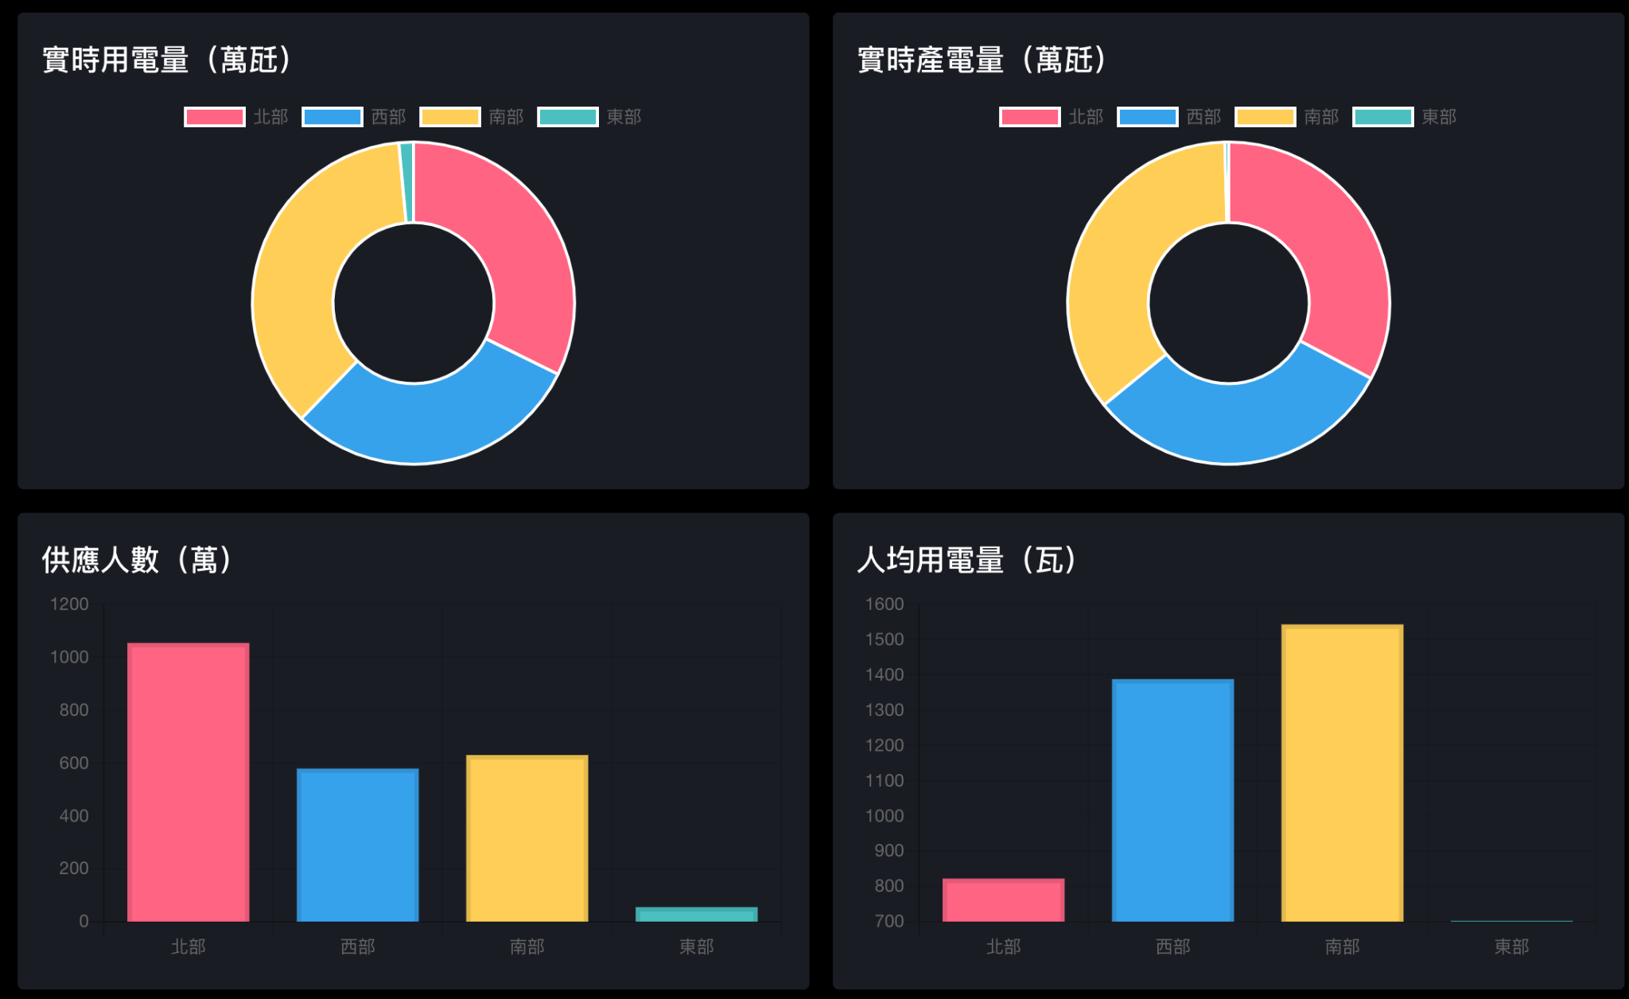
UI/UX design - Electricity
Graph:
Average usage
Realtime Generation & Usage
SuppliedPopulation
Advantages:
Trend Identification
Comparative Analysis
Visual Representation

Slide 11
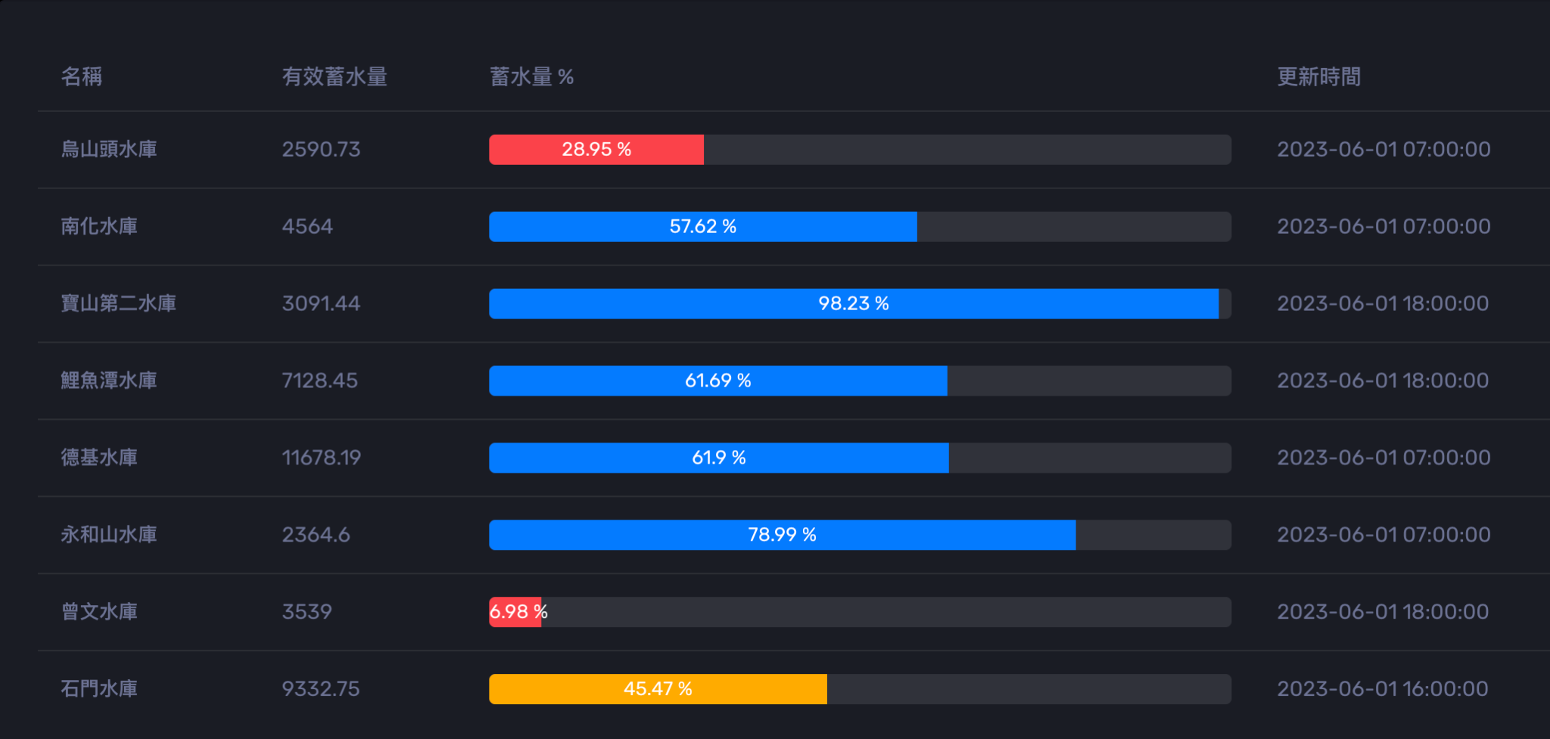
UI/UX design - Reservoir
Display charts based on reservoir water levels
e.g.,
red for less than 30%,
orange for less than 50%

Slide 12
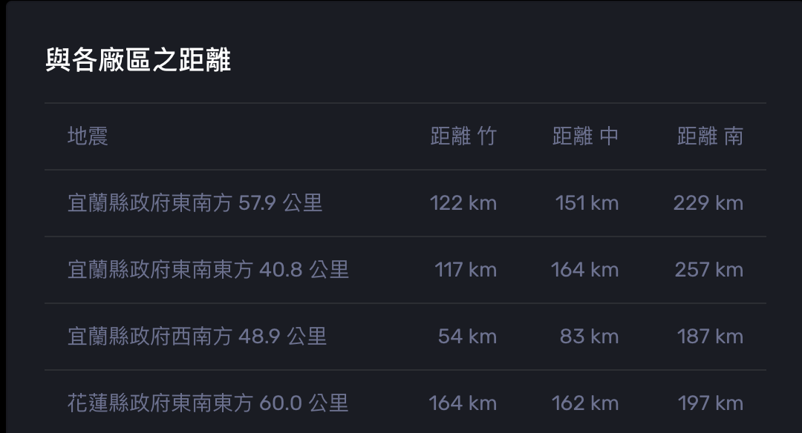
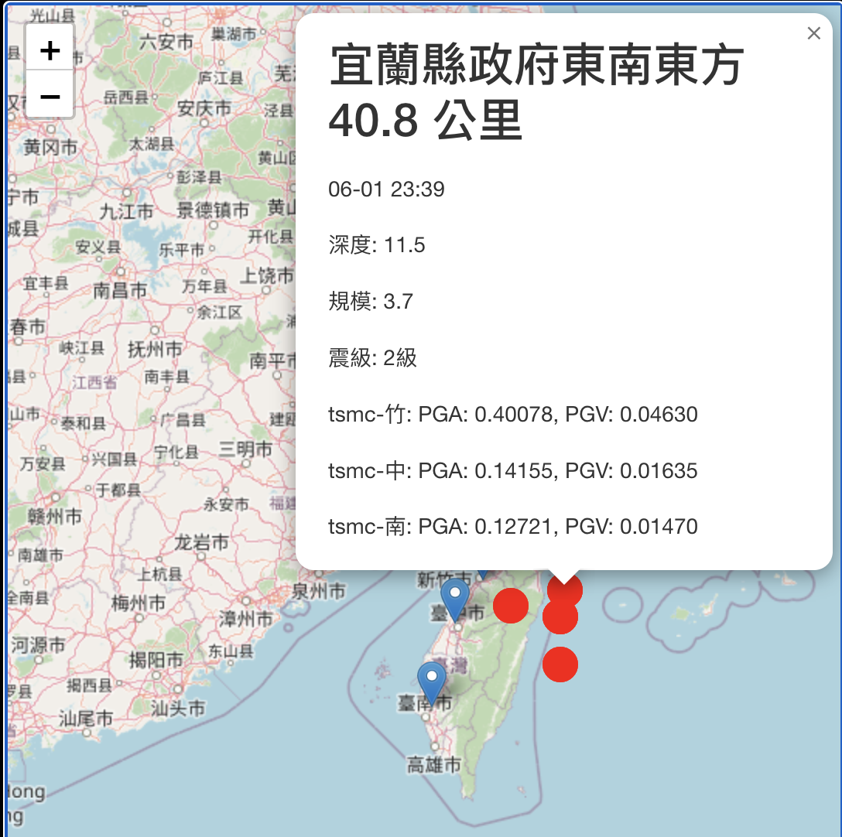
UI/UX design - Earthquake
Mark earthquake and factory site locations on the map for easy understanding of proximity.
Click on earthquakes or factory sites on the chart for additional information.
Calculate distance information for each earthquake and factory site for more precise judgments.

Slide 13
Architecture

Slide 14
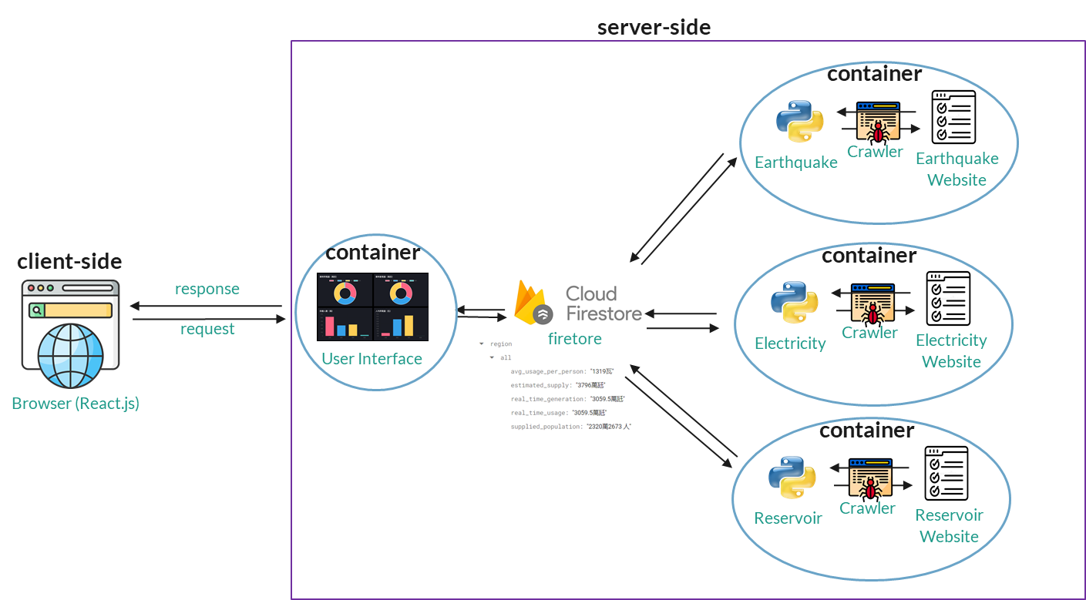
Architecture

Slide 15
User requirements &
Unit test
Earthquake
Electricity
Reservoir

Slide 16
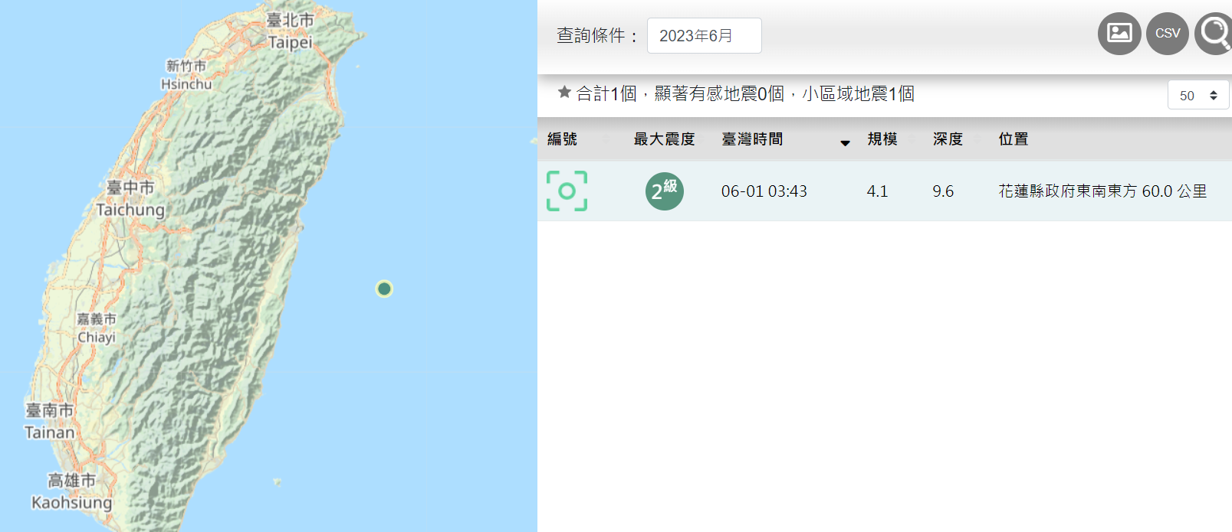
User requirements - Earthquake
Web Scraping Objective: The objective of our web scraping project is to gather real-time earthquake data from the Central Weather Bureau's Earthquake Monitoring Center.
Target Website: https://scweb.cwb.gov.tw/zh-tw/earthquake/data/
Programming Language and Tools: Python programming language and utilized libraries such as Beautiful Soup and selenium.
Features of the Web Scraper: The web scraper can retrieve various earthquake-related details such as the earthquake occurrence time, location, and intensity. This data can be utilized for earthquake monitoring, disaster alerts, and related applications.
The crawled content will be saved in the database.
Update time: When the crawling target website changes, the content of the Firebase database is updated.

Slide 17
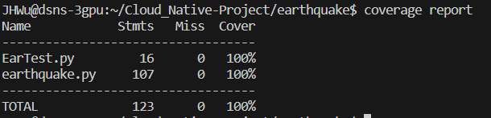
Unit test - Earthquake
Unit Testing Objective: The primary objective of our unit testing is to ensure the functionality and reliability of the earthquake web scraper program. It involves testing individual units or components of the code to verify their expected behavior.
Test Result Evaluation: Unit test coverage reached 100%

Slide 18
User requirements - Electricity
Objective: Get real-time electricity supply and usage information to detect the potential risk of the lack of electricity.
Source: https://www.taiwanstat.com/realtime/power/
The information provided by the source covers electricity supply and usage, including the estimated maximum of electricity supply and other valuable statistics of all regions in Taiwan for better evaluation in electricity-related strategy.
Scheduling: The source updates the information hourly, at 10 minutes past the hour, so the web scrapper will activate every hour.
Storage: The data will be stored in FireStore after the web scrapping. Every update in the electricity collection will be immediately displayed on our website, so there won’t be any delay on synchronization between the frontend and the backend.

Slide 19
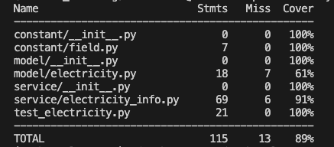
Unit test - Electricity
Program structure: The web scraper adopts the MVC-like architecture, in which codes for the interaction with the database are under “model”, and the main logic of scrapping web elements and processing the data are under “service”.
Unittest objective:
To ensure the logic of processing data is conforming to the specs.
Coverage report

Slide 20
User requirements - Reservoir
Objective: To detect risky real-time statistics and information related to reservoirs from the Taiwan Water Resources Agency.
Target Website: https://fhy.wra.gov.tw/ReservoirPage_2011/Statistics.aspx
Water information time
Storage effective
Percentage of WaterStorage
Scheduling: crawling the newest information on the hour
Storage: stored in FireStore

Slide 21
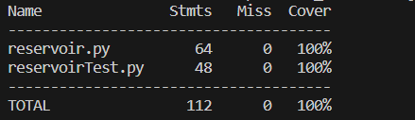
Unit test - Reservoir
Process flow:
crawling website per hour -> choose target data -> store in firestore
Unittest objective:
To ensure if the program crawling on the hour
To validate that the date to be stored in Firebase matches our target data.
To verify if the update to Firebase was successful.
Unit test coverage reached 100%

Slide 22
The 12 Factors

Slide 23
12 Factors
No. | Title | Satisfaction | Explanation
1 | Codebase | O | All the codes are stored in the single repo on GitHub.
2 | Dependencies | O | Using package.json and requirements.txt to manage dependencies.
3 | Config | X
4 | Backing Services | O | By update the serviceAccountKey.json we can quickly change to another fireStore database.
Notes:
Config: 應該要有像是 Java Spring Boot 的 properties 檔案可以配置程式中需要的一些參數，像是 firebase 的 key 那些。 如果我們把 firebase 的 key 等等有另外寫在配置檔應該就可以符合。

Slide 24
12 Factors
No. | Title | Satisfaction | Explanation
5 | Build, Release, Run | O | We use docker commands to build the images and run the containers.
6 | Processes | O | UI, alarm service and web scrappers are all containerized independently.
7 | Port Binding | O | We bind 3000 port to our website.
8 | Concurrency | X

Slide 25
12 Factors
No. | Title | Satisfaction | Explanation
9 | Disposability | O | We can simply use "docker-compose up" to start the service and "docker-compose down" to stop it.
10 | Dev/prod parity | O | In the Dockerfile, we specify the same base image, maintaining consistent system dependencies, and installing Python dependencies from requirements.txt.
11 | Logs | O | We can check logs through docker.
12 | Admin processes | O | We can check and generate alarms through 3001 port.

Slide 26
分工
陳麒鈞：User Stories, (後端) Alarm Service, (前端) homepage 開發及 UI 整合, docker-compose 撰寫, CI 架設及維護, README.md 資料彙整, 上台報告
周芝妤：firebase firestore 資料庫建立, firestore CRUD operation (python/node.js) , 整理 firestore CRUD 說明文件, 協助整理 User story
Crawler & unit test & Containerization
Earthquake : 巫建泓
Electricity：張偉誠
Reservoir：顏琳恩
UI layout, 圖表製作：江佳穎

